Slide 1
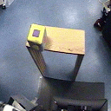
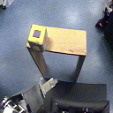
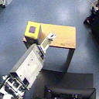
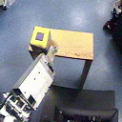
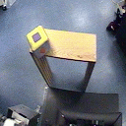
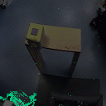
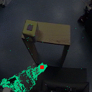
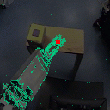
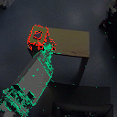
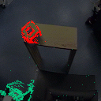

Slide 2
Edges of table and cube overlap
Color of cube and table are poorly separated
Cube has misleading surface pattern

Slide 3
Edges of table and cube overlap
Color of cube and table are poorly separated
Cube has misleading surface pattern

Slide 5
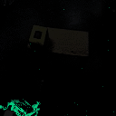
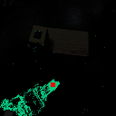
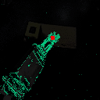
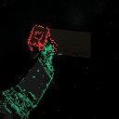
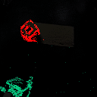

Slide 6
X translation
Y translation
Translation
in depth
In-plane
rotation
Rotations
in depth
4 DOFs are trackable through projected appearance
2 DOFs remain:
point on surface

Slide 9
shoulder (a)
shoulder (b)
elbow (a)
elbow (b)
wrist (a)
wrist (b)

Slide 10
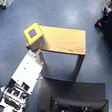
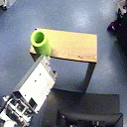
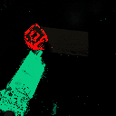
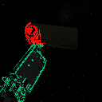

Slide 11
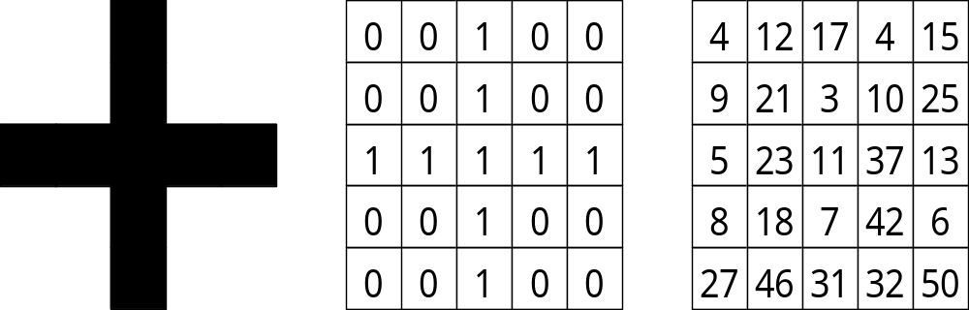
A cross
A binary cross
??

Slide 12
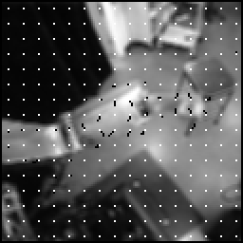
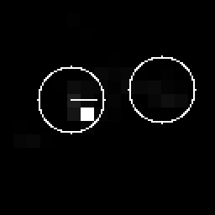
Optical flow
Maximum
Segmented regions

Slide 13
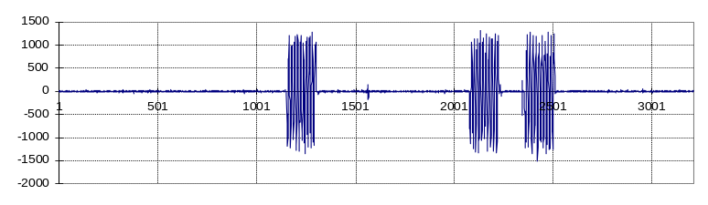
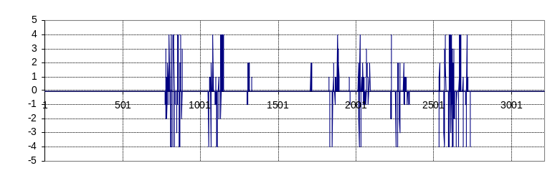
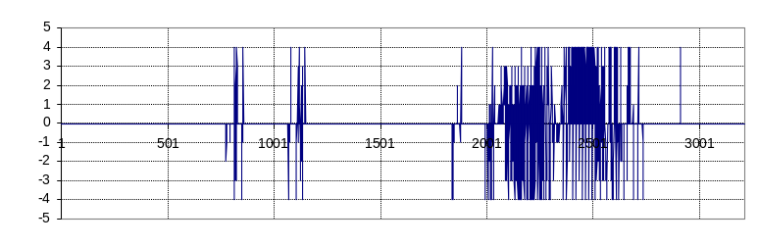
Joint speed (wrist)
Block (12,7)
optic flow (uncorrelated)
Block (10,5)
optic flow (correlated)

Slide 14
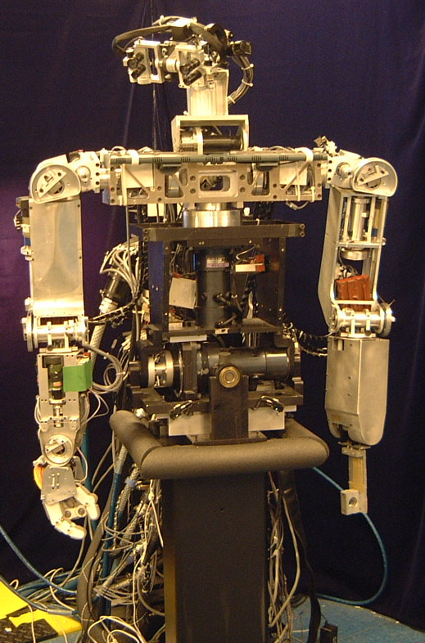
Head
(7 DOFs)
Right arm
(6 DOFs)
Left arm
(6 DOFs)
Torso
(3 DOFs)
Stand
(0 DOFs)

Slide 15
gaze
open loop
controller
+
postural
primitives
visual
error
closed loop
controller
low-level
control
oscillatory
movements
arm locator
robot joint position
not implemented yet!

Slide 17
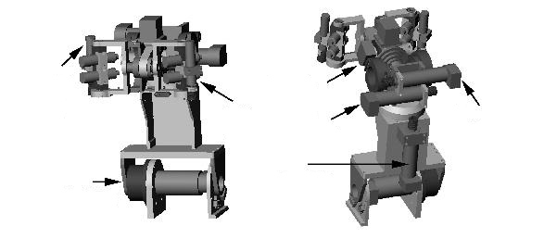
X translation
Y translation
Translation
in depth
In-plane
rotation
Tangent region shifts when head rotates in depth

